Slide 1

Hotel Booking Analysis Project
Understanding booking patterns, cancellations & customer behavior

Slide 2
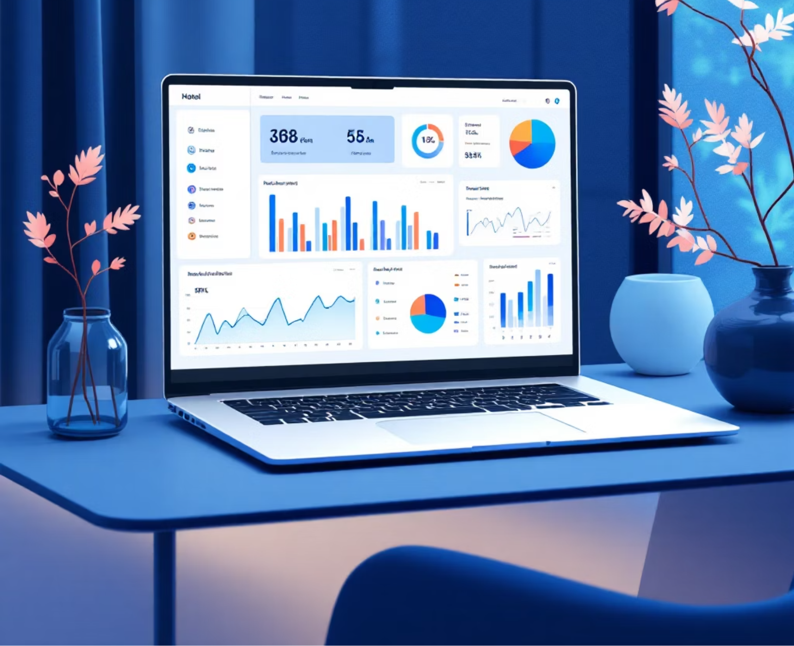
Project Overview
Our Objective
We study hotel booking data to find smart ideas that helps hotel improve themselves and make customer happier.
Key Focus Areas
When people book the most (seasons and patterns)
Why people cancel and what happens after
What different types of guests like
How hotels can make more money
Which ads and websites work best

Slide 3
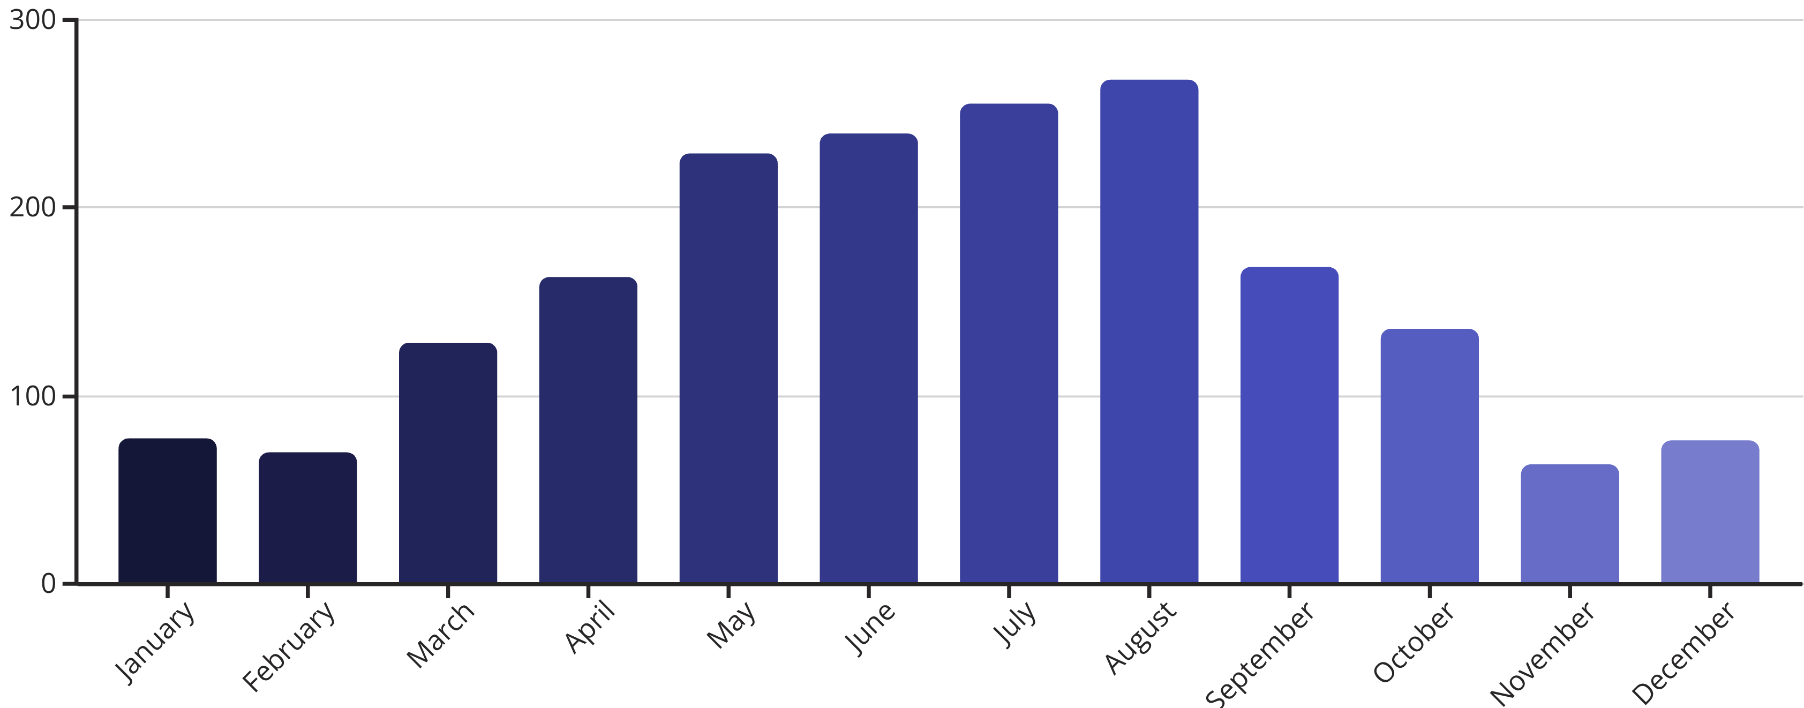
Booking Pattern Analysis
Seasonal trends and customer behavior insights from booking data are crucial for strategic planning.
Peak Season
Weekend Demand
Early Bookings
July & August show highest booking volumes.
Consistent 35% higher demand on weekends.
68% of bookings made 30+ days in advance.

Slide 4
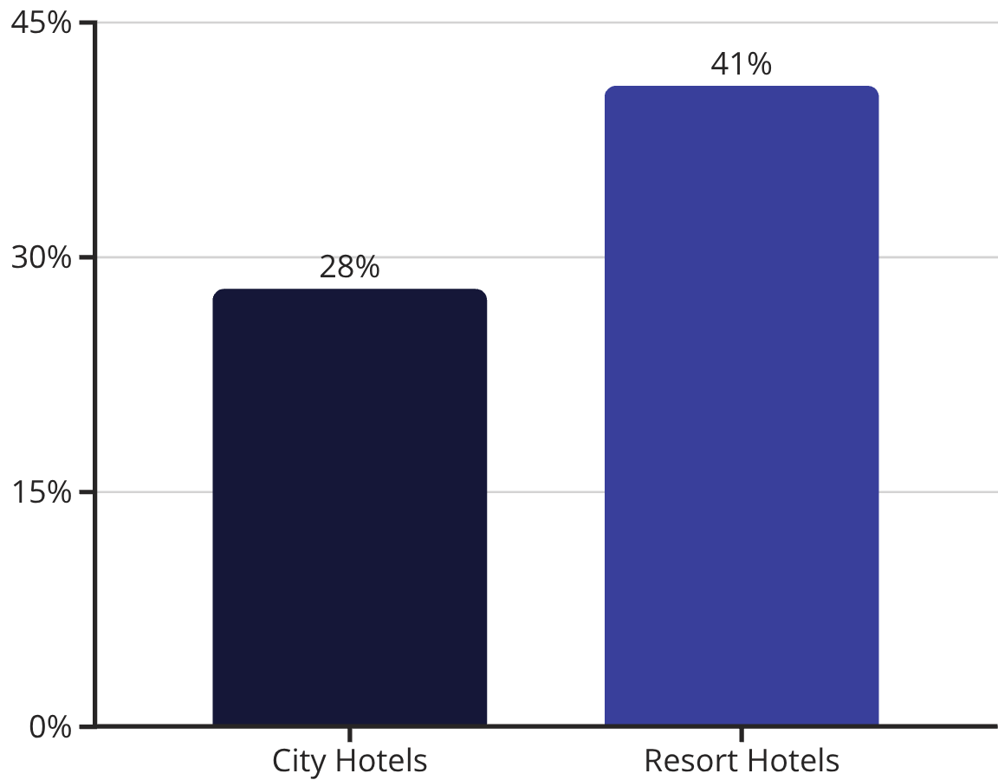
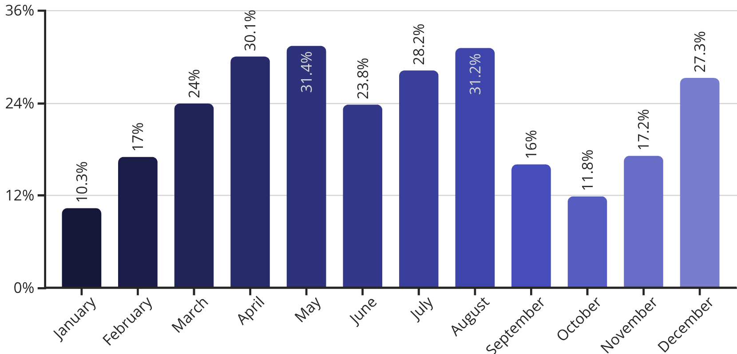




Why Do People Cancel Hotel Bookings?
Understanding why hotel bookings are canceled helps us improve our income and operations. This analysis looks at the main reasons guests cancel their rooms so hotels can create better ways to prevent this.
Better Prices Elsewhere
Strict Cancellation Rules
Guests often cancel after finding better prices elsewhere — matching competitor rates can reduce cancellations.
Strict rules like non-refundable rates or high cancellation fees discourage commitment and increase cancellations.
Uncertain Travel Plans
Booking Too Early
Resort bookings face higher cancellations due to personal changes, weather, and group plan uncertainties.
Bookings made far in advance (90+ days) are more likely to be canceled due to changing travel plans.

Slide 5
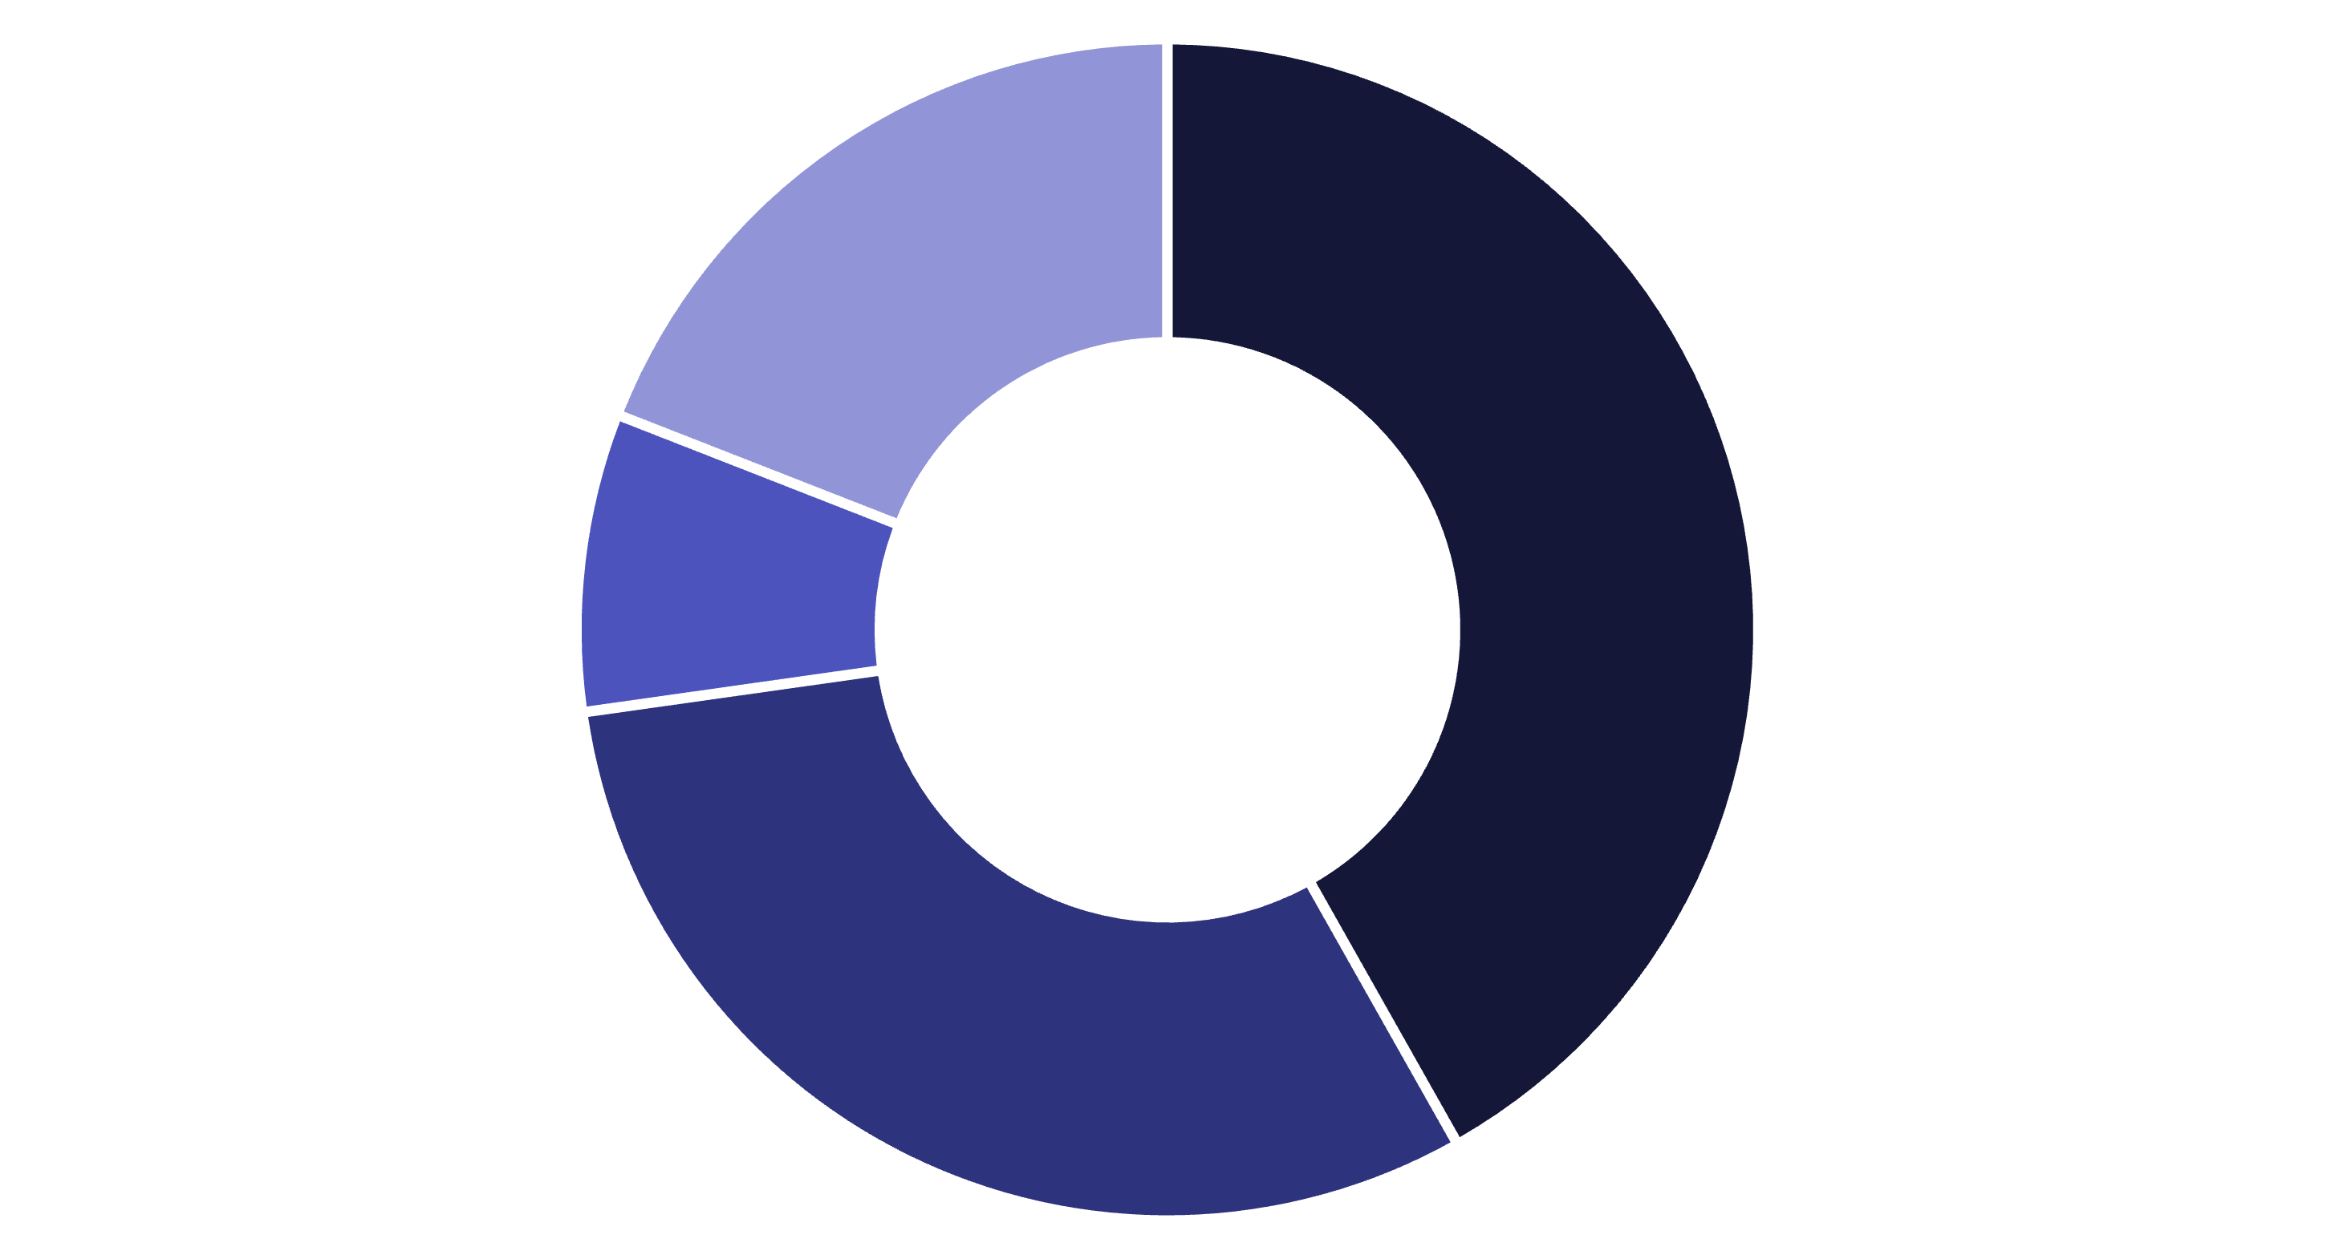



Customer Behavioral Segmentation
Different guest segments have distinct preferences and booking behaviors that drive personalization strategies.
Individuals
Family and Friends
Groups
Contract
Families
Business Travelers
Group Travelers
Prefer resort properties with longer 5-7 day stays. Prioritize amenities like pools and kids' clubs.
Favor city hotels with 1-3 night stays. Value efficiency, WiFi, and proximity to business districts.
Book for events or tours, often with a long lead time, and require minimal special attention.

Slide 6
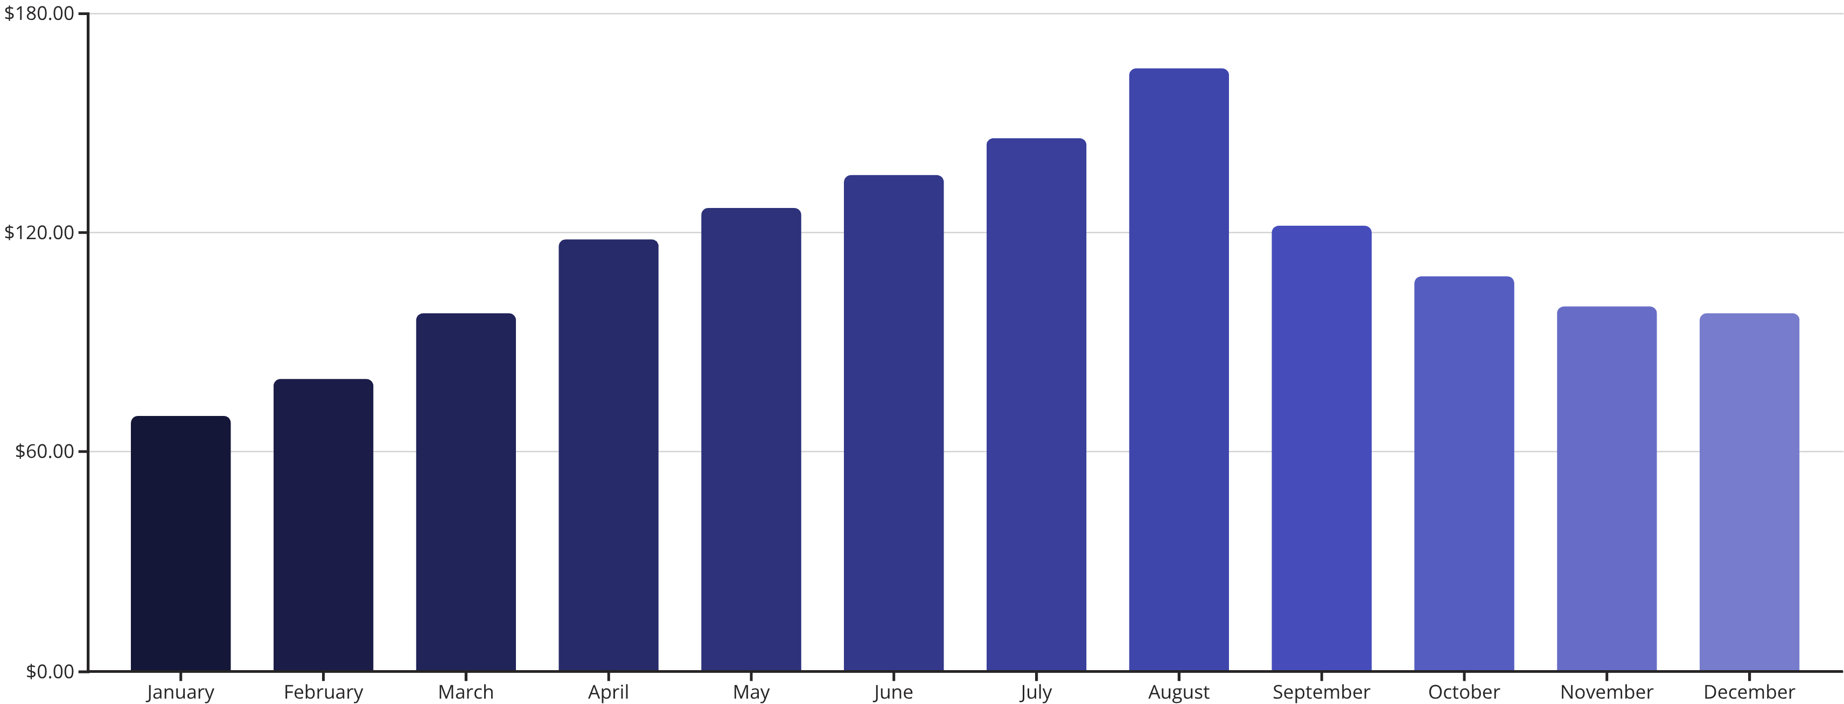
Revenue Management Insights
Strategic pricing optimization drives significant revenue improvements across seasonal demand cycles.
47%
28%
$43
Peak Season Premium
Revenue Increase
Off-Peak Discount
Higher rates during summer months maximize revenue potential
Dynamic pricing implementation versus static rate strategy
Strategic rate reductions drive occupancy in slow periods

Slide 7





Operational Efficiency Challenges
Booking Demand
Seasonal spikes create resource planning complexity for hotels nationwide.
Cancellation Impact
High cancellation rates disrupt staffing schedules and inventory management.
Last-Minute Pressure
Same-day bookings stress housekeeping, front desk, and maintenance teams.
Forecasting Solution
Advanced analytics improve staff allocation and room management efficiency.
Implementing predictive forecasting models reduces operational stress by 34% and improves guest satisfaction scores.

Slide 8
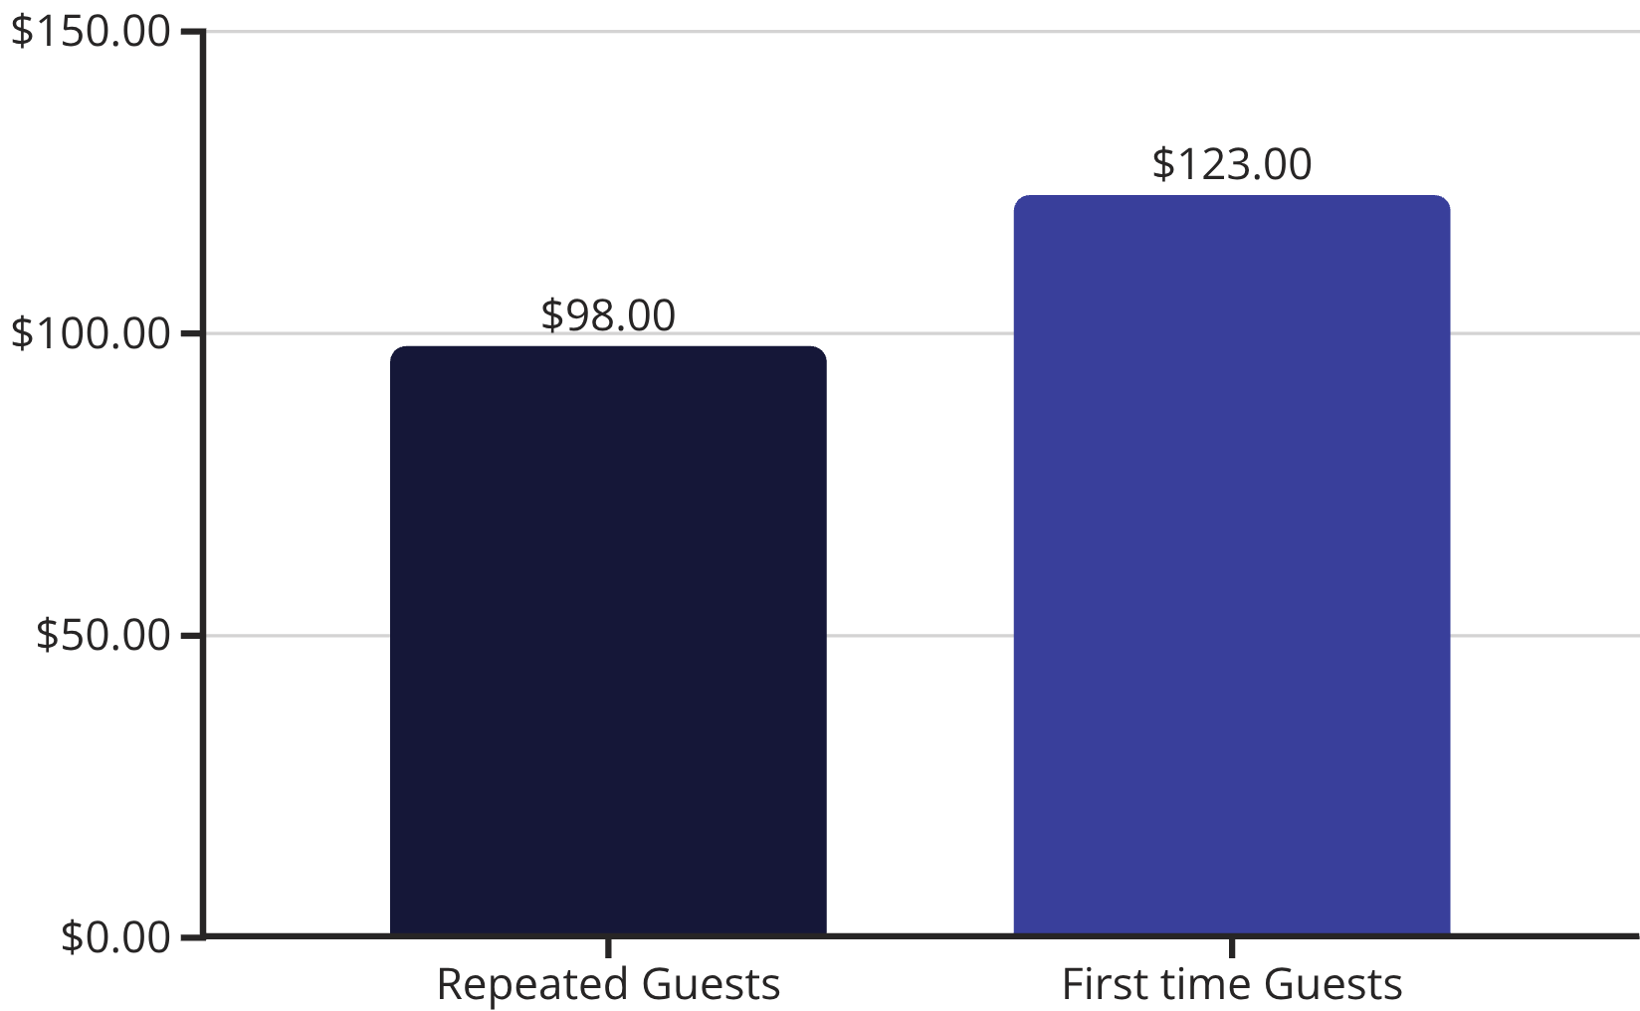

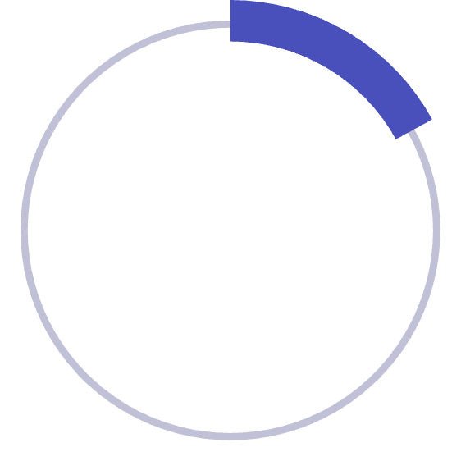
Loyalty Programs & Repeat Business
Most hotel guests are first-time visitors, presenting significant opportunities for loyalty program growth and revenue expansion.
Guest Retention Opportunities
83%
First-Time Guests
New visitors represent untapped loyalty potential
Loyalty Program Benefits
17%
Room upgrades and early check-in privileges
Points redemption for free stays
Exclusive membership and packages
Personalized service recognition
Repeat Visitors
Loyal customers spend 40% more per stay

Slide 9
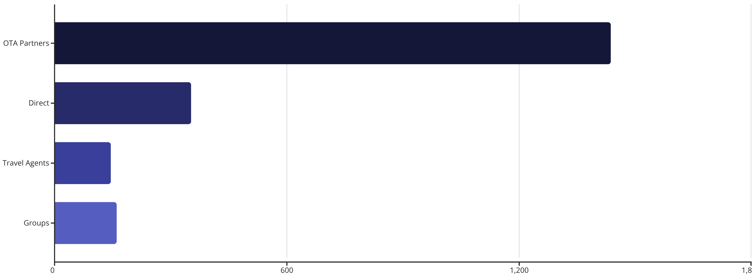



Marketing & Customer Satisfaction
Digital channels dominate booking preferences while satisfaction drivers focus on seamless experiences.
Speed Matters
Family Focus
Personal Touch
Express check-in reduces wait times and improves first impressions
Tailored packages with activities boost satisfaction scores
Customized experiences based on guest preferences drive loyalty

Slide 10

Key Insights & Strategic Recommendations
Key Findings
Recommendations
Seasonal booking patterns create predictable revenue cycles
Implement flexible cancellation policies to reduce guest anxiety
High cancellation rates impact operational planning
Deploy dynamic pricing for seasonal optimization
Digital channels dominate guest acquisition
Strengthen digital marketing and direct booking incentives
Customer segmentation reveals distinct behavior patterns
Develop robust loyalty programs for repeat business
Conclusion
Data-driven strategies combining flexible policies, dynamic pricing, and personalized experiences will drive both revenue growth and enhanced guest satisfaction in today's competitive hospitality market.

